Slide 1
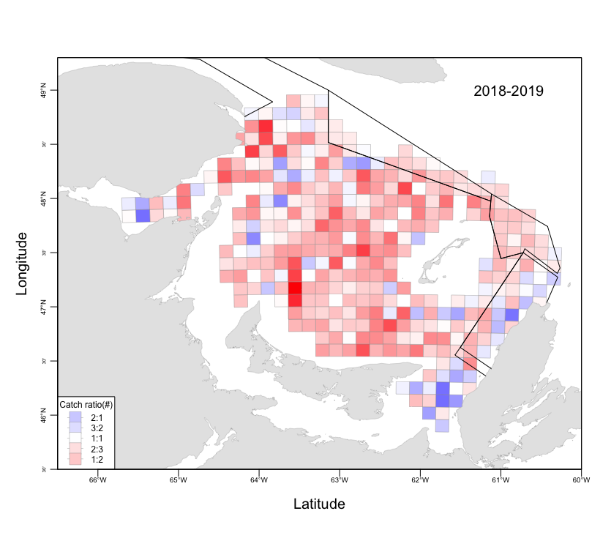
Increase in passive phase duration 2019 vs 2018:

Slide 2
Comparison of catch and passive phase increases
Males 35 <= CW <= 95 mm
Passive phase duration

Slide 3
2020 Commercial male distribution:

Slide 4
2016-2020 Commercial male distribution:

Slide 5
2019 catch adjustment:
For each tow we have that:
2018
p’
2019
a
p
2019
a
p’
p-p’
Variable | Description
p' | Passive phase swept area in 2018
a | Active phase swept area in 2019
p | Passive phase swept area in 2019
Correction factor:
f = (a + p’) / (a + p)

Slide 6
Assessment of snow crab status does not depend on having unbiased estimates of population abundance and biomass, only that the scale of any bias remains constant between regions and through time.
In other words, abundance and biomass indices are valid and useful tools for this assessment, though estimated mortality and exploitation rates, as they are presently calculated, are likely systematically biased.

Slide 7
Approach:
Underlying idea:
There are all these processes changing through time … so how do we resolve them? i.e. how do we tease each of them out so that we can draw informative inferences?
The approach is to be as informative about the different processes as possible, but not so much that we are forced to make unreasonable assumptions.
Informative:
structural information i.e. how the model is put together,
Informative parameters: prior constraints (fixed, distributions, ranges).
Hopefully most of these processes are predictable, i.e. sufficiently stable that they can be used as a baseline for processes that we are interested in, e.g. catchability and mortality.

Slide 8
Perspective:
Models are developed, different versions are examined and tested using diagnostics. They are not true, but they can be useful. Knowing the limits of their reliability is key. A model should be used insofar that it is useful and objective for the purposes it is being used. i.e. different objectives = different models.
When key processes are well modeled, they can allow for a contextualized assessment of quantities of interest (idea of signal and noise).

Slide 9
Specific Model Issues:
Examples of processes that are often confounded:
Trawl size selectivity and size or instar-based mortality.
Instar size structure is hard to infer for larger sizes, especially in males.
Model correlations can flatten some effects or processes into irrelevance.
Models can be so obtuse that it is very difficult to properly evaluate its performance.

Slide 10
Strategy:
Explain changes in annual size-distribution by modeling:
Population recruitment
Growth (size increase & moulting)
Natural mortality
Survey selectivity
Survey catchability
Fishery removals (fishing mortality)
Insert size-frequency figure

